Slide 1
Community GitHub Example Program Repository

Slide 2
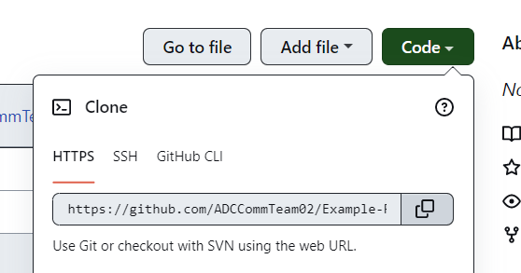
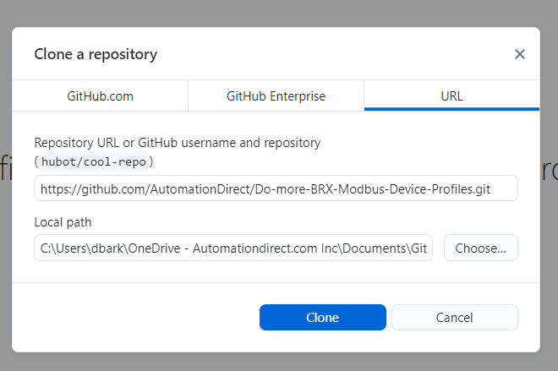
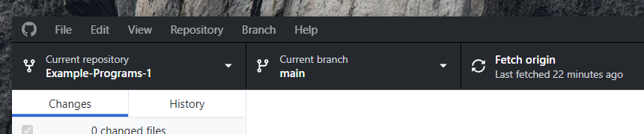
1.) Install GitHub Desktop onto your PC. https://desktop.github.com/
2.) If already have an account sign in or create new account.
3.) Clone the repository
a. Go to https://github.com/ADCCommTeam02/Example-Programs
b. Click on code dropdown & copy the repository address.
4.) In GitHub desktop select:
a. Click on File -> Clone Repository
b. Click on URL tab and paste URL from previous step
and select clone.
5.) You will now see Example Programs is selected as the
current repository.

Slide 3
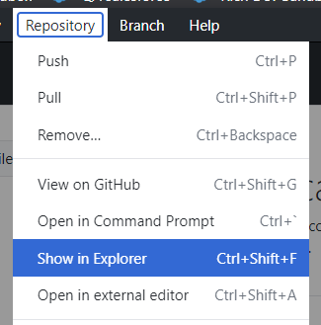
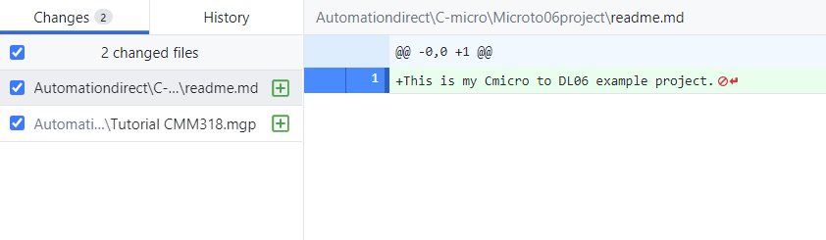
6.) Next you will want to create a new project folder in the existing Customer folder.
a. Click on repository and then show in explorer.
b. Go to Customers folder -> select a product folder
c. If your product is not listed put project into MISC
folder and admin will make and put into folder.
d. Right click and create a new project folder name
and put all files into the folder.
e. Also inside project folder create a notepad file & name it readme.md.
This will be used as title page. So, open the file and give as much detail
about your example project.
7.) Once all files are in project folder go to desktop app and
you will see all changes in left hand column

Slide 4
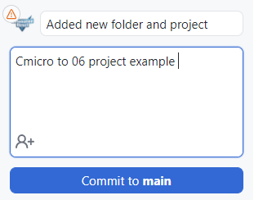
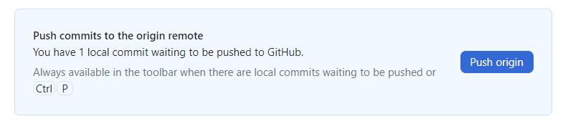
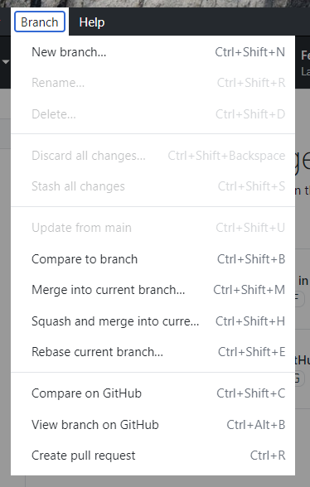
8.) Add a description & summary -> then click on “commit to main”.
9.) Select “Push to Origin” This will push changes up to GitHub.
10.) Now select Branch -> Create a pull request

Slide 5
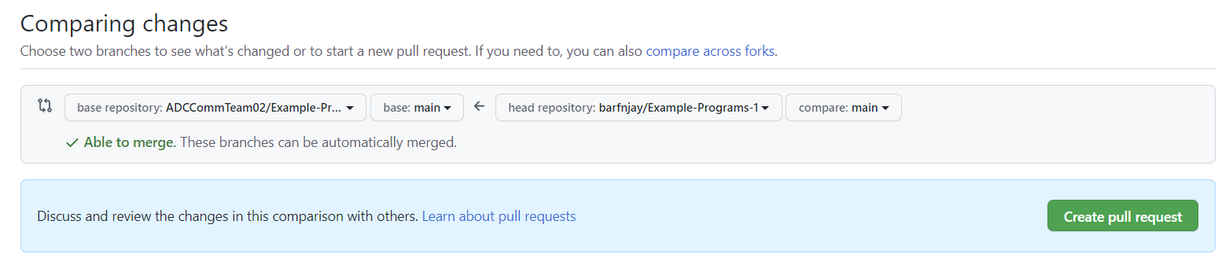
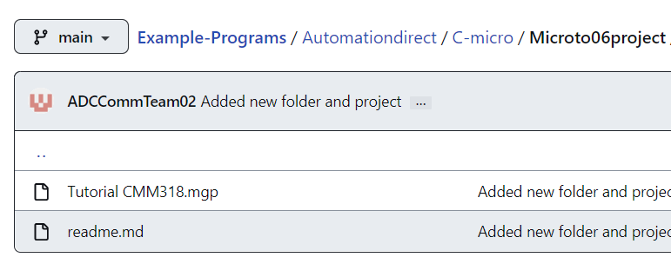
11.) This will open a comparing changes screen in GitHub. Now select “Create pull request” then “Create pull request” again.
12.) This will trigger an email to AutomationDirect.com to look over the request.
13.) AutomationDirect will review the ‘Pull Request’ and ‘Merge’ it into the repository if it is approved.
14.) You will get email notification and then your project will be available on GitHub.

